Slide 1
Repurpose your electronics or prepare them for disposal
Tweak an old phone to use it for something new! Explore some ways to turn your outdated device into a security camera, a music player, an alarm clock, and more.
If you can’t repurpose, learn where and how to properly dispose of devices you no longer need

Slide 2
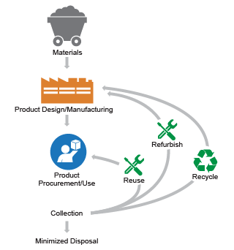
https://www.epa.gov/smm-electronics/basic-information-about-electronics-stewardship

Slide 3
Three options for old Technology
Repurpose
Resale / refurbish
Recycle

Slide 4
Repurpose
Computers
Try a different operating system
Create a dedicated media computer.
Devices
Use as a Webcam / Security Cam (Remote Camera, Security Camera)
Alarm clock (Apple Nightstand mode, Google Clock App https://www.wired.com/story/how-to-use-phone-as-bedside-clock/ )
Picture frame (https://www.slashgear.com/1226041/how-to-repurpose-your-old-tablet-into-a-digital-picture-frame/ )
Music Player

Slide 5
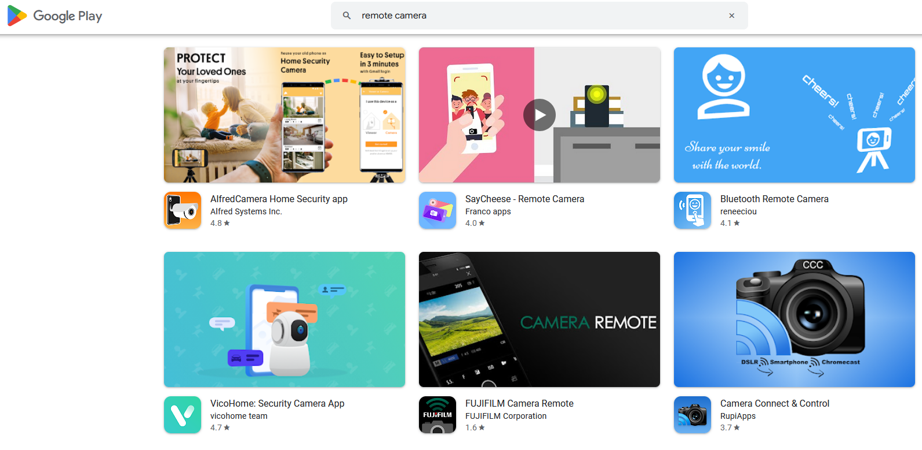
Search the Apps Store for
Remote Camera
webcam
Security Camera

Slide 6
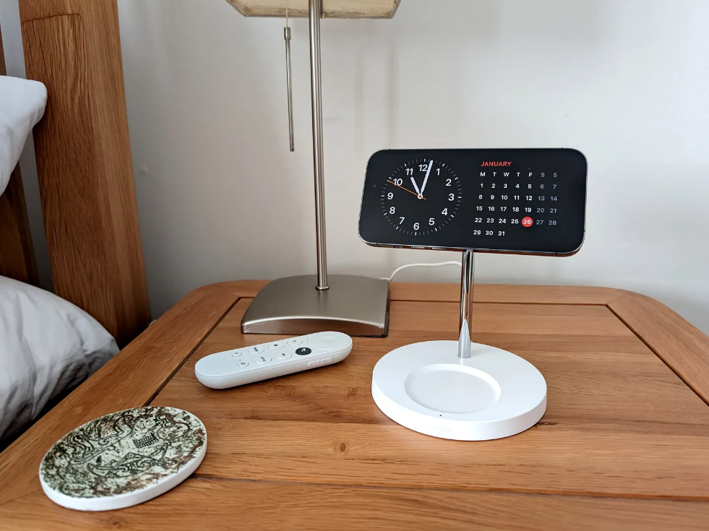
Alarm Clocks
Alarm clock (Apple Nightstand mode, Google Clock App https://www.wired.com/story/how-to-use-phone-as-bedside-clock/ )

Slide 7
Other Uses
https://www.pcmag.com/how-to/uses-for-your-old-smartphone
Music Player
Emergency Phone
TV Remote
Digital Picture Frame https://www.ibtimes.com/heres-how-turn-old-android-digital-photo-frame-3648783

Slide 8
Resale / Refurbish
Upgrade individual parts
Prepare the device for resale or to give away
Find a place to donate

Slide 9
Computers
Remove your data
Wipe your drives
Reinstall Operating System
Windows
https://support.microsoft.com/en-us/account-billing/before-you-sell-or-gift-your-xbox-or-windows-pc-78ee8071-c8ab-40c4-1d89-f708582062e4
Apple
https://support.apple.com/en-us/HT201065

Slide 10
Apple devices
What to do before you sell, give away, or trade in your iPhone or iPad
https://support.apple.com/en-us/109511

Slide 11
Android devices
https://www.theverge.com/21419919/delete-data-android-phone-sell-trade-how-to

Slide 12
Dispose of your device
https://www.co.jefferson.wa.us/696/Electronics-Recycling
Electronics: E-Cycle Washington - Washington State Department of Ecology
Computers 4 Kids (C4K) (ospi.k12.wa.us)
Green PC Recycling | Computer & Electronics Recycling | 3627 South 54th Street, Tacoma, WA, USA (greenpcwa.com) https://digitunity.org/

