Slide 1
Email Phishing
Jefferson County Library Tech Tuesday March 4, 2024

Slide 2
Goals for today
Understand the difference between Spam and Malicious emails.
Learn the difference between Unsubscribing VS declaring an email as Spam.
Understanding URLs and Proper email address construction
Learn 5 common attributes of Phishing Emails, Texts, social media and Phone scams

Slide 3
SPAM
spam
noun
\ ˈspam
Definition of spam
: unsolicited usually commercial messages (such as e-mails, text messages, or Internet postings) sent to a large number of recipients or posted in a large number of places
https://www.merriam-webster.com/dictionary/spam

Slide 4
Malicious Email
A type of email sent to trick the recipient into giving away personal information or to install software of some type on the recipient’s computer.

Slide 5
Phishing
Phishing is a cybercrime in which a target or targets are contacted by email, telephone or text message by someone posing as a legitimate institution to lure individuals into providing sensitive data such as personally identifiable information, banking and credit card details, and passwords.
https://www.phishing.org/what-is-phishing

Slide 6
Indicators of a malicious email
Email addresses and URLs do not look genuine.
There is a suspicious attachment.
There is a call to action button (possibly a panic button)
The email is poorly written.
The email asks you to confirm personal information.
Are you expecting the email

Slide 7
The structure of a URL
https://edu.gcfglobal.org/en/internet-tips/understanding-urls/1/

Slide 8
3 Parts of a valid email address
Username
@
Domain Name
dheaton@jclibrary.info

Slide 10
Malicious email example
Email addresses and URLs do not look genuine. | tisha@pvvs.bz
There is a suspicious attachment. | Signed Out standing Invoice.xlsx
There is a call to action button (possibly a panic button) | Panic and Click on Invoice
The email is poorly written. | Not addressed to an individual not very informative
The email asks you to confirm personal information.
No, I was not expecting this email
Notes:
dqtrainer.jclibrary@gmail.com

Slide 11
tisha@pvvs.bz
2 V = 1 W

Slide 12
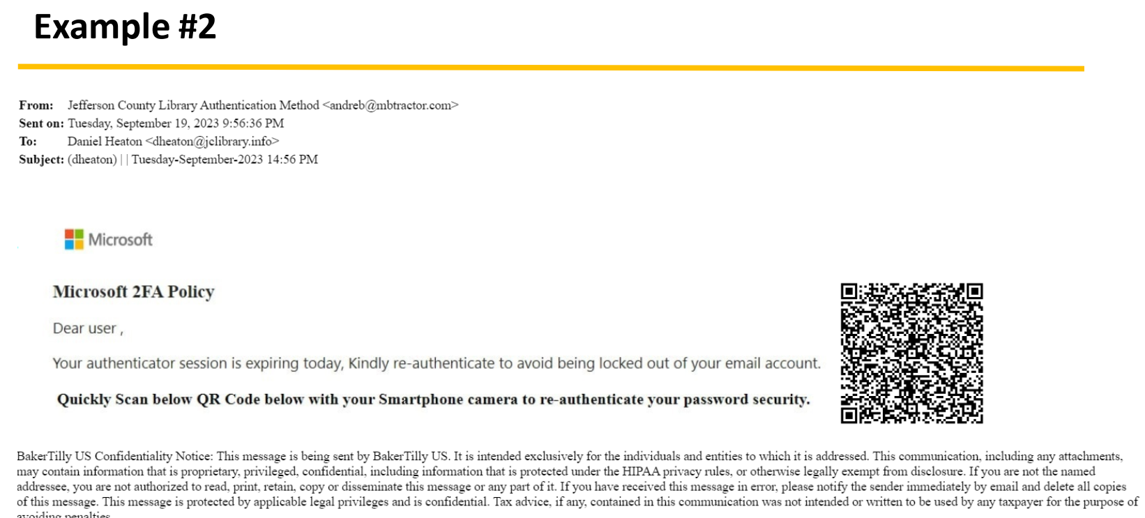

Slide 13
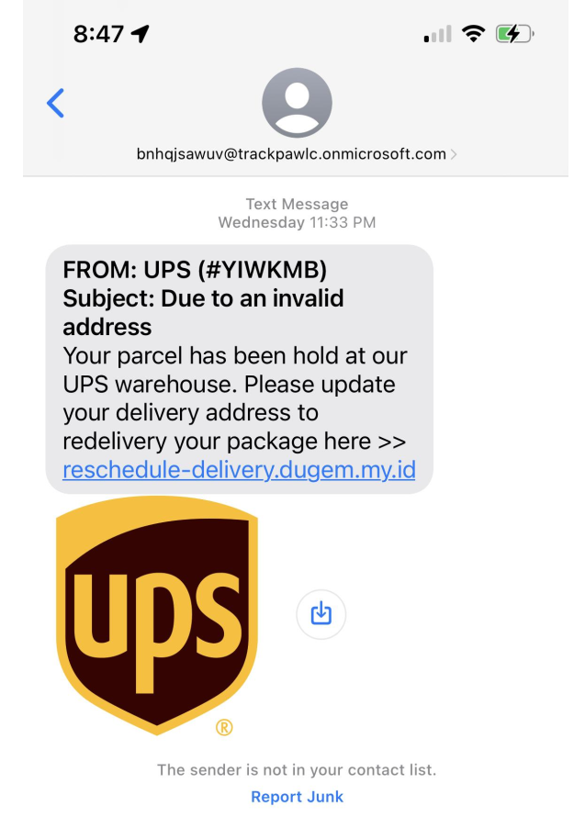
Example 3

Slide 14
Phishing Quiz
https://www.zonealarm.com/promotions/zonealarm-phishing-quiz

Slide 15
What to do if you think you've been phished
Write down as many details of the attack as you can recall. Try to note any information such as usernames, account numbers, or passwords you may have shared.
Immediately change the passwords on those affected accounts, an anywhere else that you might use the same password.
Confirm that you have multifactor authentication turned on.
If you shared information about your credit cards or bank accounts you may want to contact those companies as well to alert them to possible fraud.
If you've lost money, or been the victim of identity theft, report it to local law enforcement.

Slide 16
Resources
https://www.knowbe4.com/phishing
https://staysafeonline.org/
https://www.dhs.gov/stopthinkconnect-toolkit
https://haveibeenpwned.com/
https://blog.malwarebytes.com/101/2018/06/five-easy-ways-to-recognize-and-dispose-of-malicious-emails/
https://staysafeonline.org/blog/5-ways-spot-phishing-emails/
https://www.ted.com/talks/james_veitch_this_is_what_happens_when_you_reply_to_spam_email?utm_campaign=tedspread&utm_medium=referral&utm_source=tedcomshare or search for: Ted Talk James Veitch spam email

