Slide 1
Google Service
Tech Tuesday
11/14/23

Slide 2
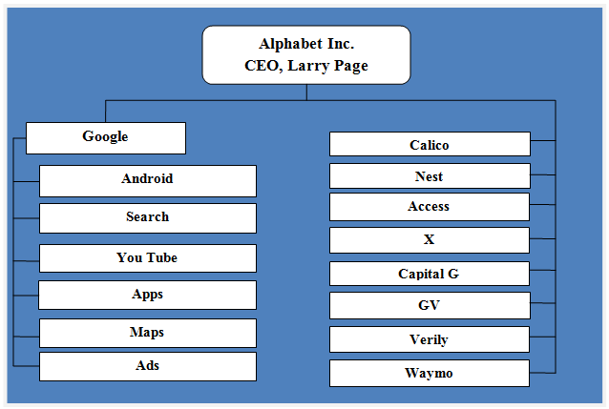
What do I mean by Google Service
Google’s Parent company is called Alphabet Inc. they have a number of brands, products, and services.

Slide 3
Today’s focus
Gmail and Calendar
Google Drive
YouTube
Google Docs, Sheets, and Slides

Slide 4
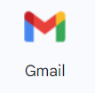
Gmail
Gmail – Web based email access. It can also be accessed by other email clients such as Outlook, Thunderbird and Apple Mail.
Let’s look at:
Different Views of the Inbox
Reading Pane
Categories
Conversation View vs Individual Mail view
Composing a message
Vacation Responder

Slide 5
Calendar
Viewing a Calendar
Sharing a calendar
Creating events

Slide 6
Google Drive
Store documents
Create Files and Folders
Sync with a Computer
Share Files

Slide 7
YouTube
Explore Videos
Upload your own videos
Save videos to watch later

Slide 8
Docs, Sheets, and Slides
Googles versions of
Word, Excel and PowerPoint.

