Slide 1

Health Information Literacy
Useful tools and resources to help locate and access accurate and reliable health information on the internet.

Slide 2
What we will cover
Definition of health literacy
Importance of family health history
Your genetic health
Understanding a website
Reliable online resources
Preparing for a visit

Slide 3
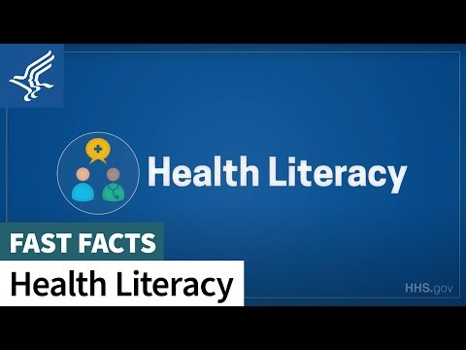

Slide 4
Personal Health Literacy
Is the degree to which individuals have the ability to:
Find
Understand
Use
information and services to inform health-related decisions and actions for themselves and others.

Slide 5
Organizational Health Literacy
Is the degree to which organizations
equitably enable individuals
To:
Find
Understand
Use
Information and services to inform health-related decisions and actions for themselves and others.

Slide 6
Why is health literacy important?
Build trust between patient and health care provider
Increase health equity
Improve quality of care
Eliminate health care disparities
Practices should include:
  Plain language
  The use of preferred language and communication channels
  Respect cultural and language differences
  Materials that are clear and easy to understand

Slide 7
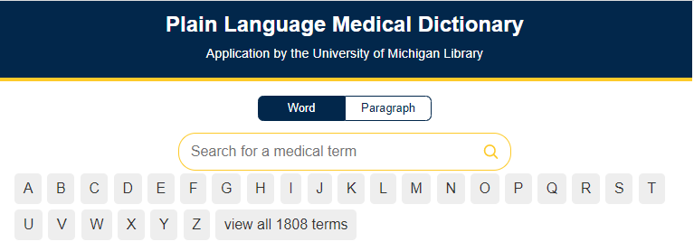

Plain Language
Plain language makes it easier for the public to read, understand, and use government communications.

Slide 8

Family Health History
What is it?
How to collect it
Why is it important?
How to use it

Slide 9
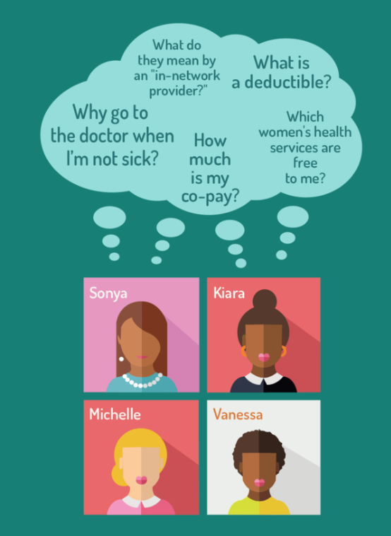
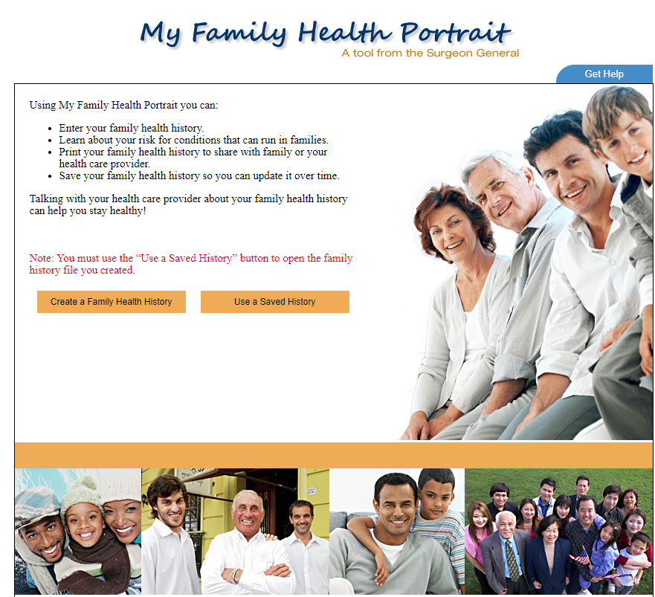
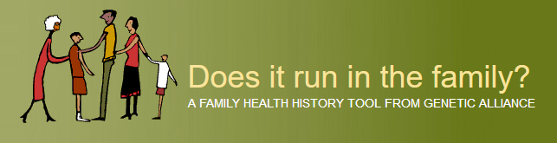
Family History Tools

Slide 10
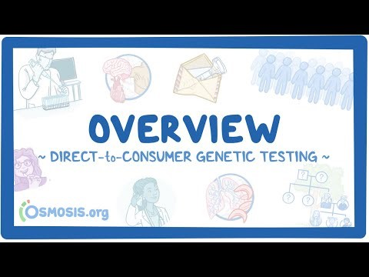
Genetic Testing - Comparison

Slide 11
Evaluating Health Websites
Credibility
Content
Disclosure
Links
Design
Interactivity

Slide 12
Website Evaluation
Credibility: Internet Mental Health
Content:
  CancerNet - Breast Cancer
  Life Extension Magazine - Tamoxifen substitute
  Pauling Therapy for heart disease
Disclosure: CVSPharmacy
Links: HealthFinder
Design:
  Public Health Agency of Canada
  Microsoft Start Health Hub
  WebMD
  MedlinePlus Health Information

Slide 13
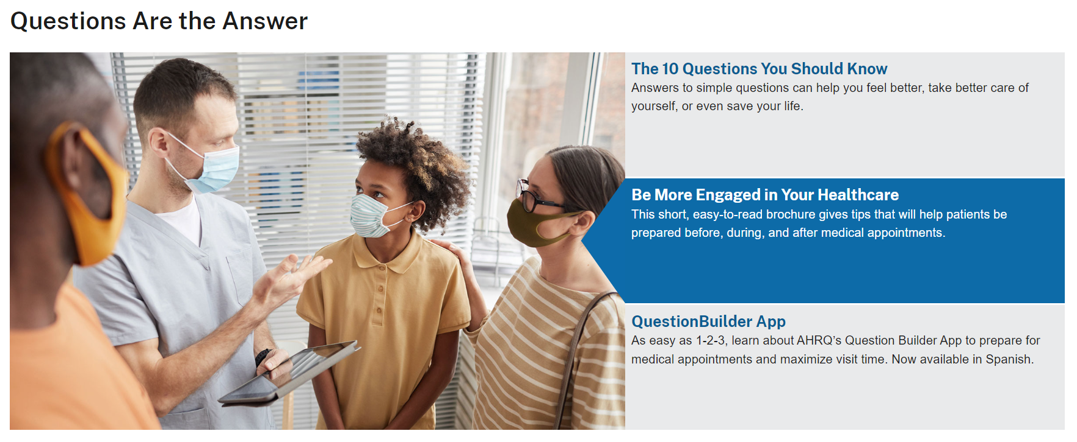

Preparing for a visit

Slide 14
10 Questions you should know
What is the test for?
When will I get the results?
How do you spell the name of that drug?
Are there any side effects?
Will this medicine interact with medicines that I'm already taking
Why do I need this treatment?
Are there any alternatives?
What are the possible complications?
Which hospital is best for my needs?
How many times have you done this procedure?

Slide 15
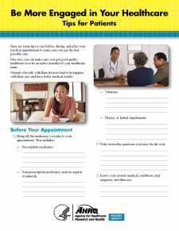
Be more engaged
Before your appointment
During your appointment
After your appointment

Slide 16
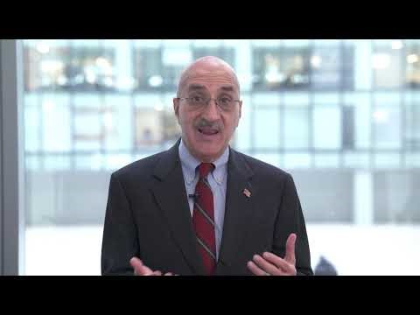
Question Builder App

Slide 17
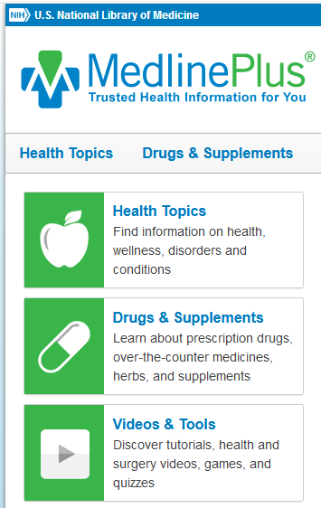
Medline Plus – A Place to Start
Evaluating Health Information
Health Topics
Medical Encyclopedia
Drugs, Herbs, and Supplements
Genetics

Slide 18

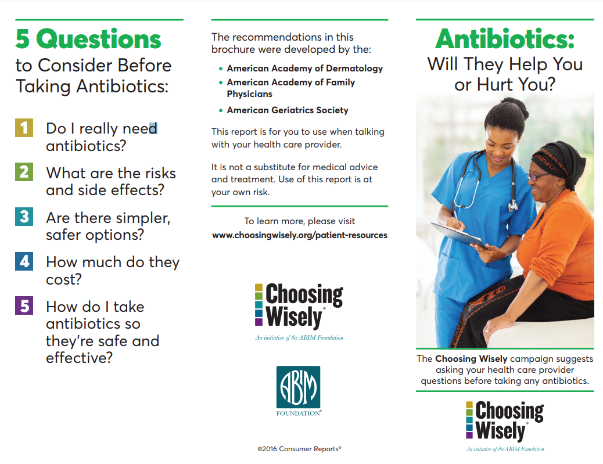
Promoting conversations between patients and clinicians
Patient Resources

Slide 19

Resources
https://cdc.gov/
https://www.hca.wa.gov/
https://ahrq.gov/
https://www.o3a.org/
https://www.o3a.org/programs/statewide-health-insurance-advisors-shiba/
https://sites.google.com/g.emporia.edu/for-your-health/home
https://jclibrary.info/research-learning/health-and-wellness/

