Slide 1

Digital Media Literacy for Adults
Useful tools and resources to help identify what is real from what is fake in a world full of misinformation, disinformation, and mal-information.

Slide 2
What we will cover
How to understand what Misinformation, Disinformation, and Mal-information is.
How false news spreads
Filter Bubbles & Echo Chambers
Why we fall for misinformation
Identifying misinformation
How to spot misleading graphs
Digital Media Literacy – further resources

Slide 3
Definitions & Language
Fake news
Misinformation
Disinformation
Mal-information
Confirmation Bias
Echo Chambers
Filter Bubbles

Slide 4
The language we use matters
Which is the least harmful?
Which is the most harmful?
Falsehood
Fabrication
Misinterpretation
Misrepresentation
Alternative Fact
Lie
Fake News?
Falsehood
Fabrication
Misinterpretation
Misrepresentation
Alternative Fact
Lie
Fake News?

Slide 5
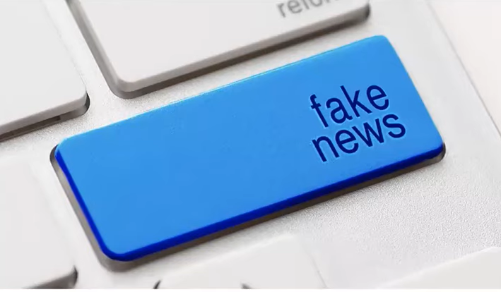
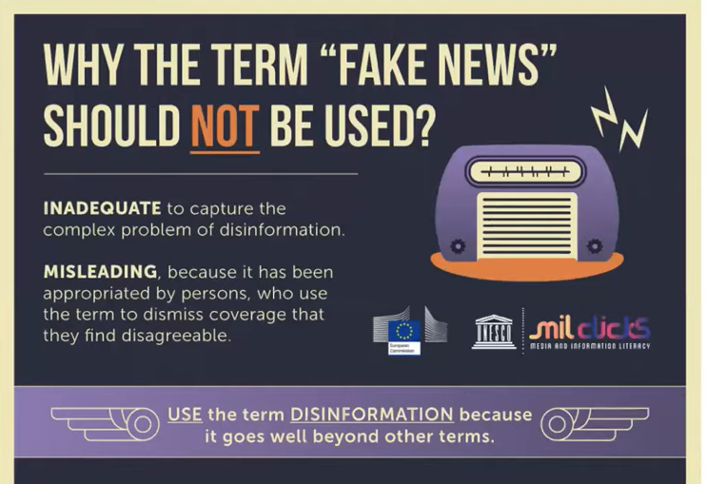
Moving away from “fake” news
Polarized
Politicized
Used to shut-down conversations.

Slide 6
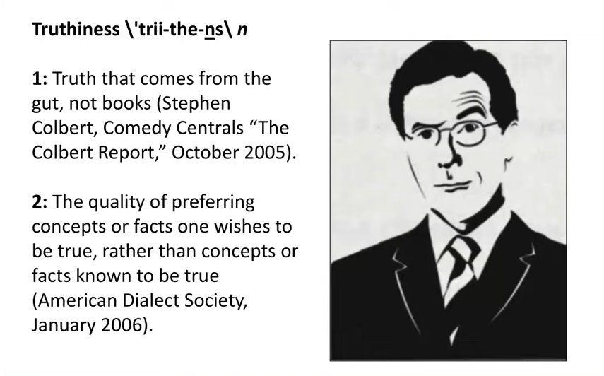

Slide 7
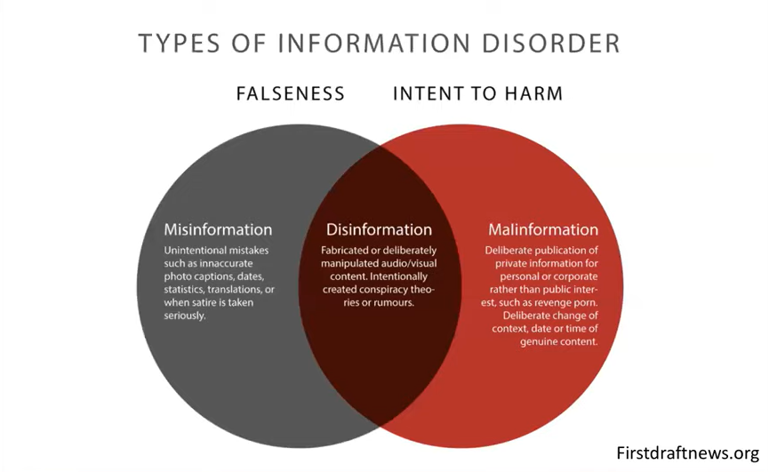

Slide 8
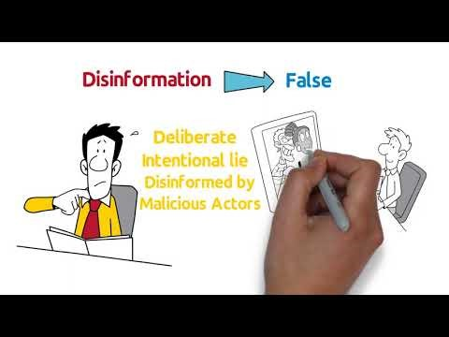

Slide 9
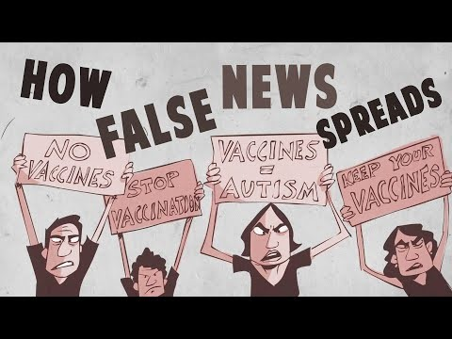

Slide 10
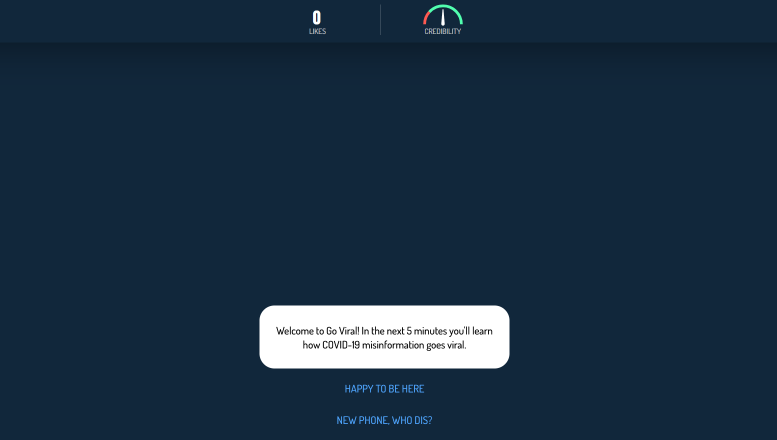

Slide 11
Why we fall for misinformation
Filter bubbles
Echo Chambers
Confirmation Bias

Slide 12
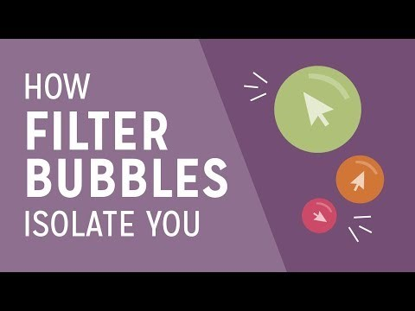
Notes:
When you visit a website, you may think you’re getting the same content as everyone else. But almost anywhere you go online, algorithms keep track of what you like to click on. These algorithms give you content based on what they think you like, and they will continue to do so until they’re mainly showing you content you’ll likely consume. This process can lead to the creation of a filter bubble.

Slide 13
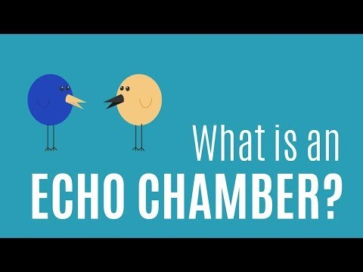
Notes:
Same perspectives over and over again. Reflect and reinforce your own opinions. Difficulty

Slide 14

How to identify Misinformation
Know….
  The source
  The content
  The facts
  The date
  Yourself

Slide 15
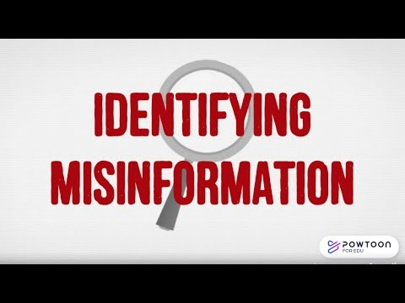

Slide 16
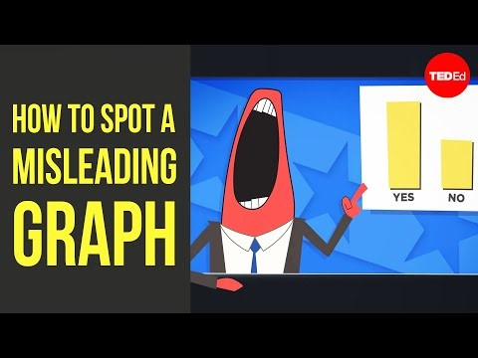

Slide 17

GCF Global – Digital Media Literacy
Self-guided tutorials and YouTube series
  Evaluating Information
  Media
  Social Media and smartphones

Slide 18
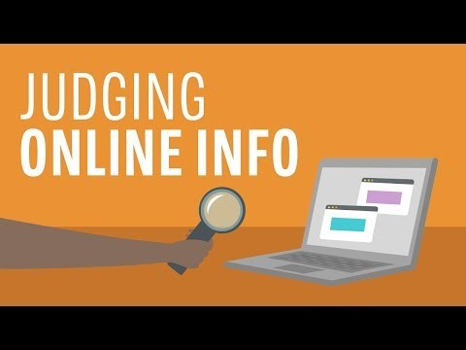
Evaluating Information
  Judging online Information
  Practice evaluating a webpage
  How to read a webpage
  What is sponsored content
  What is clickbait
  What is targeted advertising
  How ads and clicks shape the internet

Slide 19
Media
Deconstructing media messages
The problem with photo manipulation
Recognizing persuasive language
The blur between facts and opinions in the media

Slide 20
Social Media and Smartphones
  What is an Echo Chamber
  How Filter Bubbles isolate you
  What is fake news?
  How social media stars make money
  Always on in a digital world
  Why we can’t stop scrolling
  Why we can’t just pick a movie
  FOMO: or relationship on social media

Slide 21
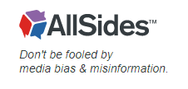
Rate your bias
Media Bias Ratings | AllSides
Media Bias Chart | AllSides
Misinformation Watch: Examples of Fake News, Fact Checking and More | AllSides
16 Types of Media Bias and how to spot them

Slide 22
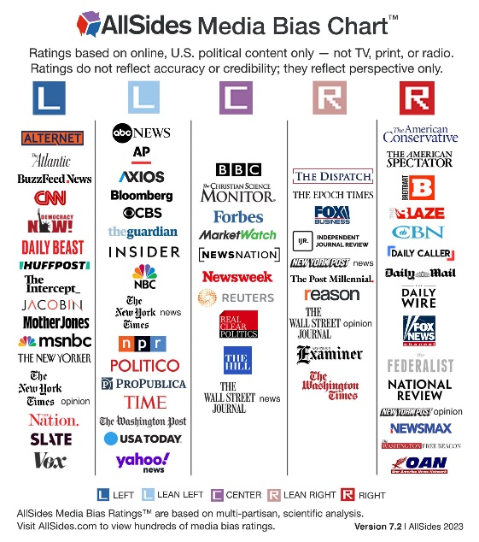
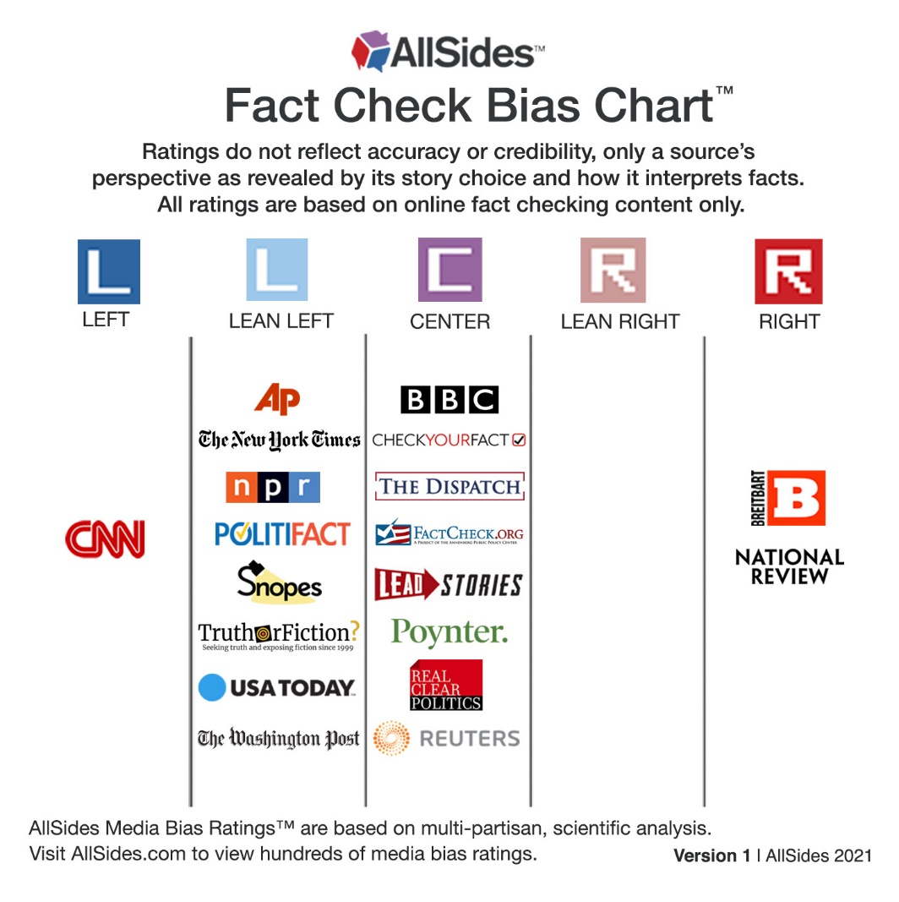

Slide 23

Resources
GCF Global Filter Bubbles
Unesco Media Literacy
All Sides Bias Rating Charts

