Slide 1
THE THIRD BRANCH:
The Supreme Court of the United States (SCOTUS)
Week 1
Nils Pedersen & Joyce Francis
Fall 2022, Jefferson County Library

Slide 2
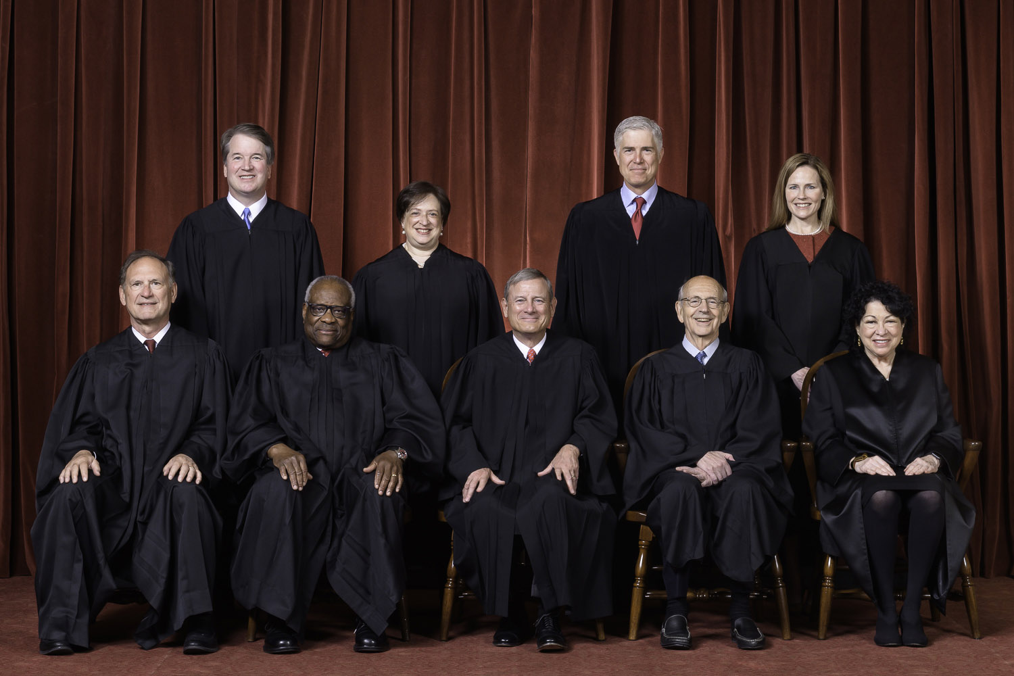
SCOTUS – OT 2021

Slide 3
SCOTUS OT 2021 OVERVIEW
Conference Co-sponsored by the National Constitution Center
& the Anti-Defamation League
Overview Speakers: https://www.youtube.com/watch?v=e0EPXnshy64
Erwin Chemerinsky, Dean, U.C. Berkeley School of Law ~2→7
Gregory Garre, Solicitor General 2008-09, ~8→13:30
Amy Howe, Journalist, ~14:30→17
Frederick M. Lawrence, former president of Brandeis & Dean of GWU Law School, ~17→18:50

Slide 4
SCOTUS Stat Pack
OT 2021 Key Findings
Last term, the court’s six conservative justices were dominant, but they were divided on how quickly to push the law in new directions. This term, the conservative majority remained dominant but was no longer divided.
One of the most momentous in the court’s 233-year history.
Decline of unanimity – Only 29% of cases were decided unanimously, the lowest in the two decades that SCOTUSblog has been tracking.
Rise of the 6-3 court – 30% of the court’s rulings on the merits were decided in a 6-3 vote. Of those 19 decisions, 14 were polarized decisions (defined by party of appointing president).

Slide 5
Key Findings (continued)
Roberts & Kavanaugh retain their power - In the majority 95% of the decisions, dissenting in only three cases this term.
Sotomayor most often in dissent – In the majority in 58% of the court’s decisions, dissenting in 27 cases.
Texas was a repeat player - The lawyers who most frequently argued before the court this term were U.S. Solicitor General Elizabeth Prelogar and Texas Solicitor General Judd Stone. Each argued in five cases, Stone for the first time in his career.
https://www.scotusblog.com/2022/07/as-unanimity-declines-conservative-majoritys-power-runs-deeper-than-the-blockbuster-cases/

Slide 6
Cases Considered in OT 2021
The 66 decisions handed down (67 last year) that constitute formal opinions of the court fall into three categories:
58 decisions in merits cases in which oral arguments were heard and signed opinions rendered (3rd fewest since Civil War, after OT 2019 and OT 2020),
3 “summary dismissals” (unsigned decisions, 2 dismissed as improvidently granted and 1 affirmance with no opinion due to a 4-4 vote), and
5 unsigned “shadow docket” decisions granting emergency relief. (Petitions requesting emergency relief issued with minimal or no written opinions. Such orders have reshaped the legal landscape in recent years on high-profile matters like changes to immigration enforcement, disputes over election rules, and public-health orders barring religious gatherings and evictions during the pandemic.)

Slide 7
Some Areas of Law in the Merits Docket Cases
Area of the Law | # of Merits Cases OT 2020 | # of Merits Cases OT 2021
Constitutional Law** | 22 | 28
Procedure & Jurisdiction | 0 | 13
Criminal Law | 9 | 9
Administrative Law | 4 | 7
Health Care | 0 | 6
Arbitration | 0 | 5
Immigration Law | 6 | 5
Environmental Law | 7 | 2
**Freedom of speech & religion; 2nd, 4th, 5th, & 6th Amendments;
Equal protection; Abortion; Habeas corpus; Sovereign immunity.

Slide 8
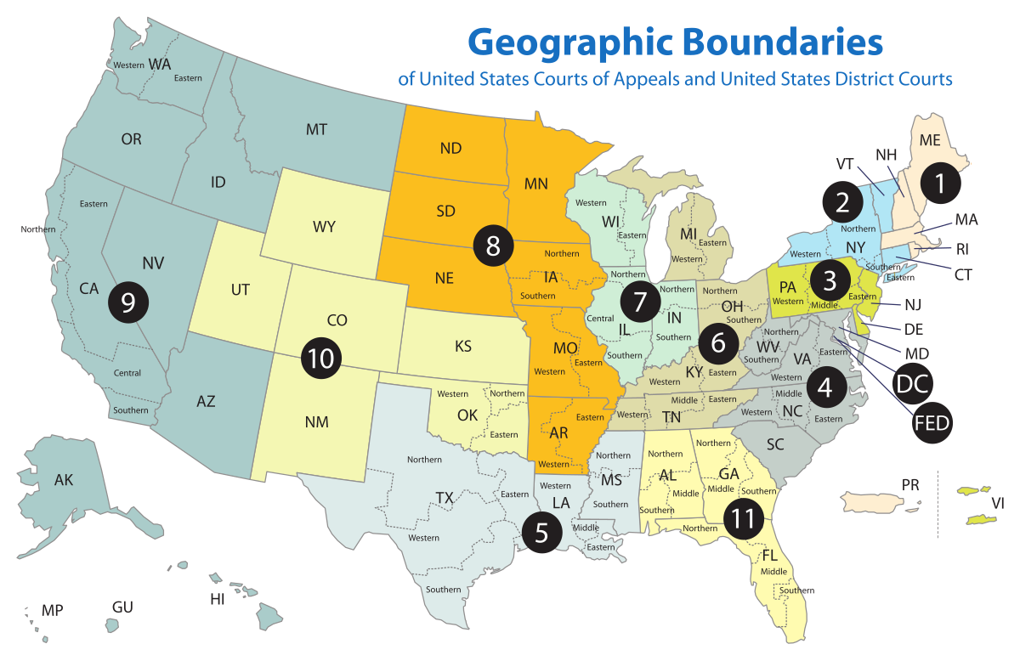

Slide 9
Circuit Scorecard OT 2021
Court Below | # (%) of Cases | # (%) Reversed
1st Circuit | 5 (8%) | 5 (100%)
2nd Circuit | 5 (8%) | 5 (100%)
3rd Circuit | 1 (2%) | 1 (100%)
4th Circuit | 3 (5%) | 2 (67%)
5th Circuit | 8 (3%) | 7 (87%)
6th Circuit | 7 (11%) | 6 (86%)
7th Circuit | 3 (5%) | 1 (33%)
8th Circuit | 2 (3%) | 2 (100%)
9th Circuit | 12 (18%) | 12 (100%)
10th Circuit | 3 (5%) | 2 (67%)
11th Circuit | 4 (6%) | 1 (25%)
D.C. Circuit | 2 (3%) | 2 (100%)
Federal Circuit | 1 (2%) | 0 (0%)
State Court | 5 (8%) | 5 (100%)
District Court | 4 (6%) | 3 (75%)
Original | 1 (2%) | 0 (0%)
TOTAL | 66 (100%) | 54 (82%)
Main appellate court for many issues of American administrative and constitutional law
Main appellate court for patent law cases
Appellate cases directly from state Supreme Courts
Appellate cases directly from a Federal District Court, bypassing Circuit Court
Appellate cases involving suits between two states

Slide 10
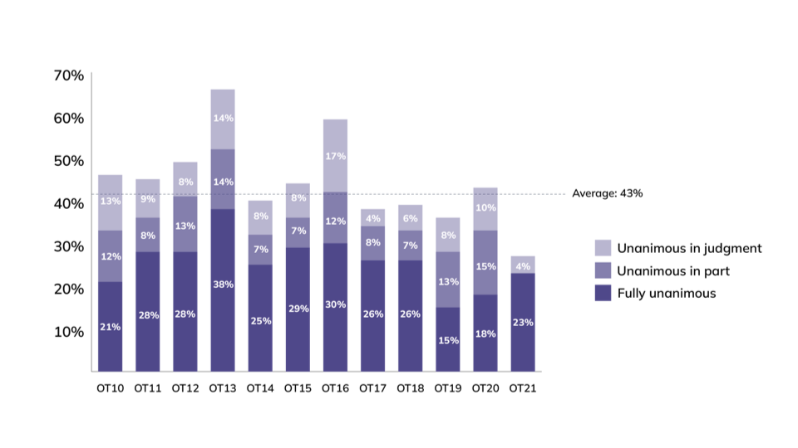
Unanimous Cases Over Time
“Unanimous in judgment” means that all justices voted for the same judgment – whether to affirm or reverse the decision below – but at least one justice did not join the opinion of the court and wrote separately.
“Unanimous in part” means that all justices joined at least part of the court’s opinion, but at least one justice wrote separately as well.
“Fully unanimous” means that all justices joined the court’s opinion in full, and none wrote separately.

Slide 11
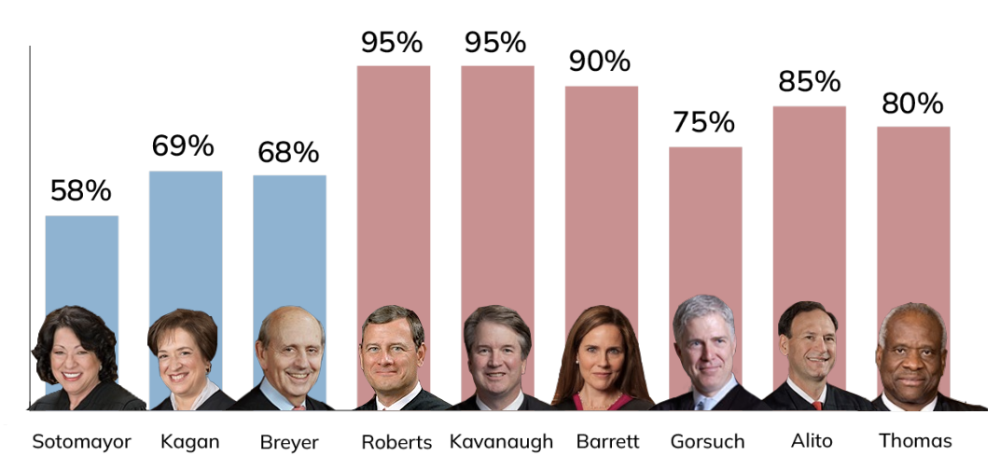
Frequency in the Majority OT 2021
NOTE: Roberts and Kavanaugh were in complete lockstep, dissenting in the same three cases.

Slide 12
Current Justices
Frequency (%) in the Majority
Over Time
Justice by Seniority | OT 21 | OT 20 | OT 19 | OT 18 | OT 17 | OT 16 | OT 15 | OT 14 | OT 13 | OT 12
Roberts | 95 | 91 | 97 | 85 | 93 | 93 | 92 | 80 | 92 | 86
Thomas | 80 | 81 | 72 | 75 | 81 | 82 | 72 | 61 | 88 | 79
Breyer | 68 | 76 | 77 | 76 | 73 | 90 | 94 | 92 | 88 | 83
Alito | 85 | 83 | 73 | 82 | 79 | 86 | 84 | 72 | 88 | 79
Sotomayor | 58 | 69 | 72 | 75 | 68 | 90 | 83 | 89 | 82 | 79
Kagan | 69 | 75 | 78 | 82 | 74 | 93 | 95 | 85 | 92 | 81
Gorsuch | 75 | 90 | 89 | 75 | 85 | 82 | - | - | - | -
Kavanaugh | 95 | 97 | 93 | 91 | - | - | - | - | - | -
Barrett | 90 | 91 | - | - | - | - | - | - | - | -
Highest % and Lowest %

Slide 13
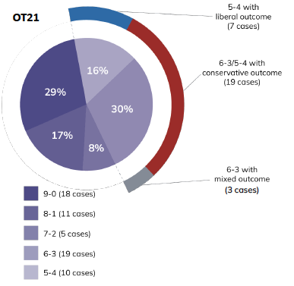
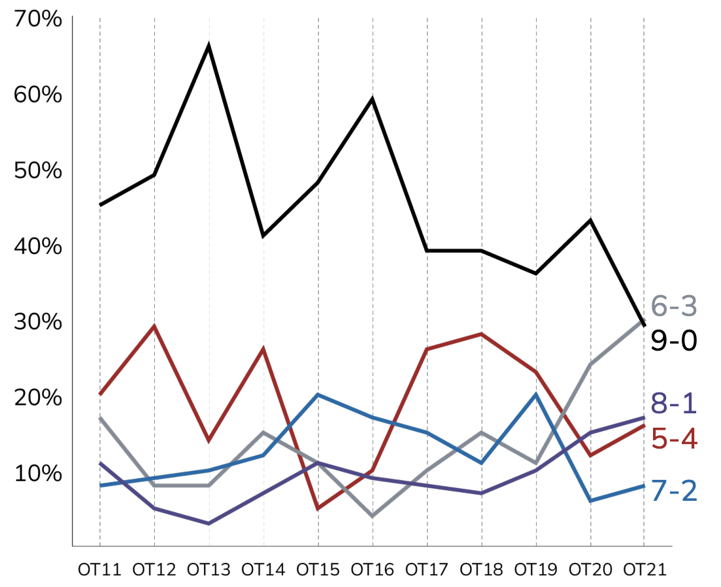
Voting Alignments OT 21 and Over Time
OT 21
Over Time

Slide 14
Current Justices
Frequency (%) in Agreement in Full OT 21
Justice by Seniority | Thomas | Breyer | Alito | Sotomayor | Kagan | Gorsuch | Kavanaugh | Barrett
Roberts | 79 | 62 | 89 | 54 | 63 | 73 | 100 | 89
Thomas OT 20 | - | 48 43 | 90 59 | 40 30 | 49 46 | 78 73 | 79 46 | 87 62
Breyer | - | - | 51 | 86 | 89 | 54 | 62 | 56
Alito | - | - | - | 43 | 52 | 81 | 89 | 90
Sotomayor | - | - | - | - | 90 | 52 | 54 | 48
Kagan | - | - | - | - | - | 56 | 63 | 57
Gorsuch | - | - | - | - | - | - | 73 | 81
Kavanaugh | - | - | - | - | - | - | - | 89
Liberals/Conservatives Most Agreement, Least Agreement

Slide 15
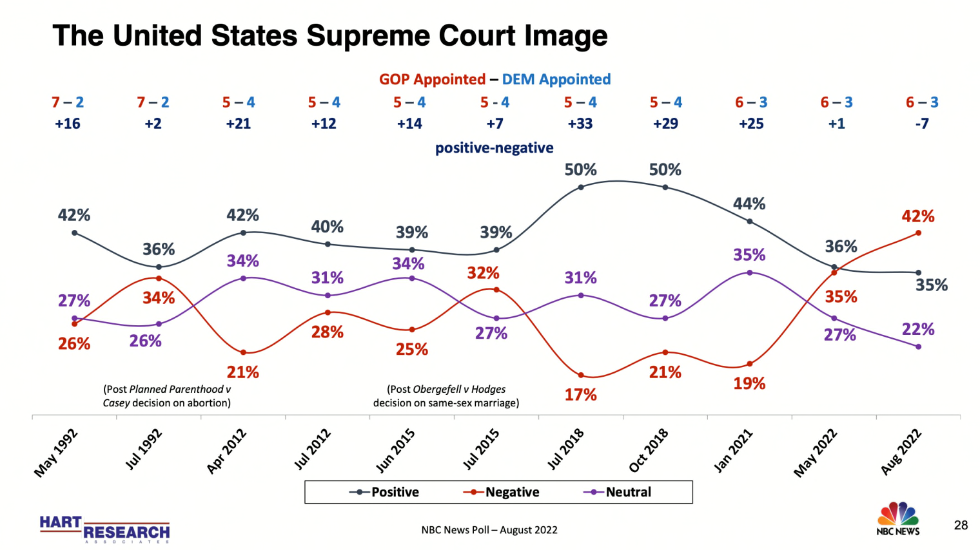

Slide 16
Preview of Cases for Week 2
ABORTION
  Dobbs v. Jackson – Overturns Roe v. Wade
RELIGION
  Kennedy v. Bremerton School District – Coach contract not renewed due to praying on football field after game.
  Carson v. Makin – Maine denies funding to religious schools in remote areas where it has outsourced education to private schools.
  Yeshiva University v. New York – University denies LGBTQ+ student association official status.
  Hope to see you next week!

