Slide 1
Security on the web
Tech Tuesday
9/6/2022

Slide 2
Today’s discussion
Stop, Think, Click
Passwords
Browsing the Web
Wireless vs Wired
Browser Addons
VPNs
URLs
Phishing

Slide 3
Stop, Think, Click
Stop - don’t rush
Think – what are you trying to accomplish? Does everything look right? Are you expecting the actions you are taking?
Once you have stopped, thought about what you are doing and everything seems OK, only then should you click.

Slide 4
Passwords
Password Strength
https://edu.gcfglobal.org/en/internetsafety/creating-strong-passwords/1/
Password Managers
The Best Password Managers for 2022 | PCMag

Slide 5
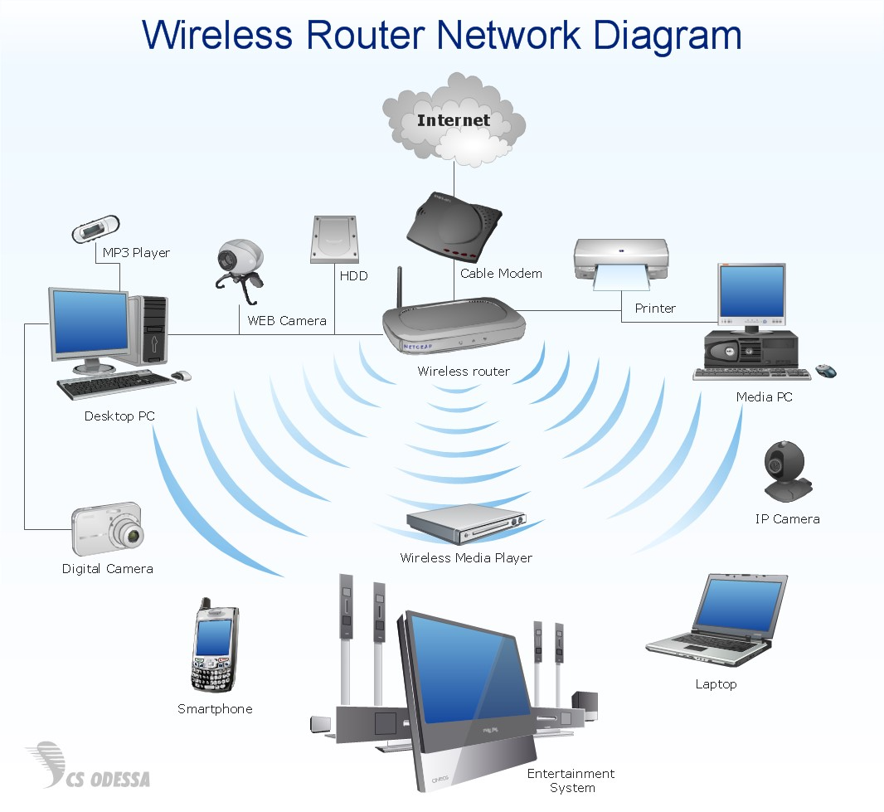
Browsing the Web
Wired VS Wifi
Browser Addons
Ublock Origin
Adblock Plus
Ghostery

Slide 6
VPNs
https://www.pcmag.com/how-to/how-to-set-up-and-use-a-vpn
https://www.cnet.com/tech/services-and-software/vpn-faq-what-you-need-to-know-about-the-basics-of-virtual-private-networks/
https://www.kaspersky.com/resource-center/definitions/what-is-a-vpn
https://www.malwarebytes.com/what-is-vpn

Slide 7
URLs
Internet Basics: Understanding URLs (gcfglobal.org)

Slide 8
Phishing
https://edu.gcfglobal.org/en/internetsafety/avoiding-spam-and-phishing/1/
Knowbe4: https://www.knowbe4.com/

