Slide 1
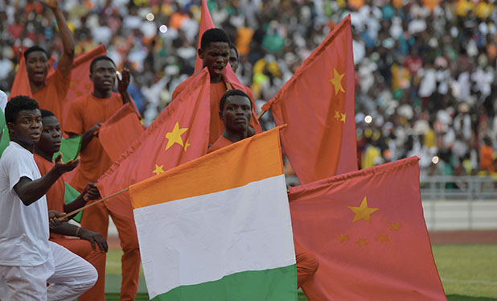
Great Decisions 2021
America’s largest foreign affairs education & discussion program.
Now in its 67th year!
CHAPTER 8
The End of
Globalization?

Slide 2
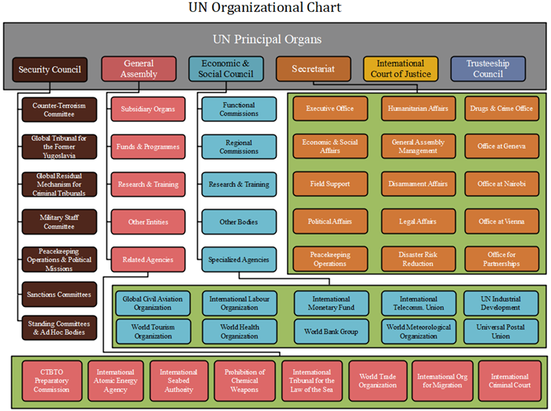

Slide 3
Divergence & Convergence in Global Well-Being
Hans Rosling’s TED Talk - “Let my data set change your mind set”
https://www.ted.com/talks/hans_rosling_let_my_dataset_change_your_mindset#t-18886
Post WWII → 1980s & 90s – West developed multilateral institutions to facilitate re-development (World Bank), monetary stability (IMF) and trade (GATT→WTO). War-ravaged Europe returned to pre-war output by 1953. Western living standards rapidly improved, leaving developing world behind (divergence)
1970s → 2010s – Newly-independent developing countries joined multilateral institutions and quickly followed West’s path to greater well-being (convergence) → middle-income countries/emerging economies

Slide 4
Globalization & Development - Correlation
Correlation – Post WWII → 2020
Well-Being Improved Worldwide - Poverty, famine, infant mortality & disease decreased while education & life expectancy increased globally
Globalization – As countries found their comparative advantage
Transport & communications costs fell 20%→<5%
Tariffs on manufactured goods in OECD countries fell 45-50%→3-5%
World merchandise trade as percent of global GDP rose 7%→60%

Slide 5
Globalization & Development - Causation
Globalization peaked ~2007 - Between 1990 and 2007, global per capita growth averaged 4.7% year-over-year but fell from 2008 to 2018 to an average of 2.3%.
Reversed Divergence – Slower growth has been most pronounced in high & upper-middle income countries, whereas lower-middle and low incomes countries have experienced higher GDP growth. Labor productivity in OECD has grown about half the rate of the pre-financial-crisis period.
Citibank Report, “For Better or Worse,” pp. 15-16

Slide 6
Rise of Trade/Globalization Skepticism
2001 – 9/11 attacks brought doubts to many in U.S.
2000s – Doha (9th) Round of Multilateral Trade Negotiations stalled as emerging countries balked. Failure generally attributed to lack of progress on reducing agricultural subsidies in advanced economies
2007-8 – Global financial crisis intensified doubts in advanced economies as manufacturing went offshore and unemployment rose
2008-15 –Obama focused more on supporting the financial system than manufacturing or those whose jobs were lost
2015-16 – Trump campaigned against all things multilateral

Slide 7
Way Forward?
Retreat – “coincides with with stagnant productivity growth and widening inequalities – a smaller pie, more poorly distributed.”
Renewed Commitment – “married with the distributional objectives of domestic policies and business decisions, is needed to revive prospects for workers, firms, and the global economy.”
Citibank Report, “For Better or Worse,” p. 18

