Slide 1
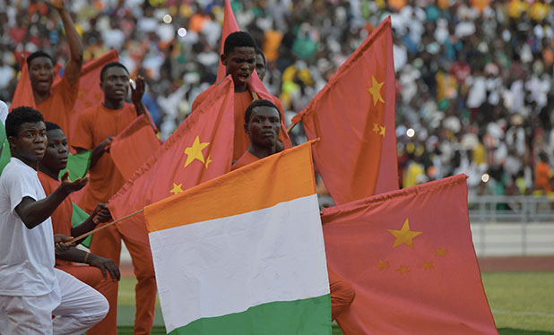
Great Decisions 2021
America’s largest foreign affairs education & discussion program.
Now in its 67th year!
CHAPTER 7
Role of the WHO

Slide 2
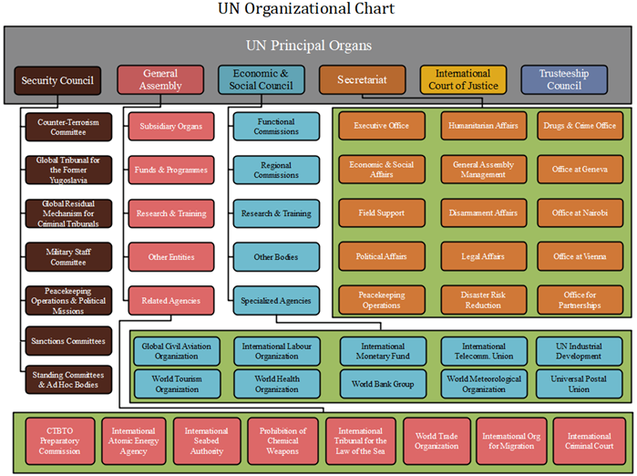

Slide 3
WHO Structure & Governance
World Health Assembly
Executive Board
Secretariat in Geneva led by Director-General
6 Autonomous Regional Offices with Director elected by member countries
150 Country Offices
194 Country Members
+ non-member observers
34 Technical Experts
Nominated by governments, EB sets
agenda & overseas implementation.
Provides guidance & support to national Ministries of Health
Regional & Country Offices comprise ¾ of Staff and ½ of Budget

Slide 4
WHO Mandate
Assemble Expertise – Global hub for gathering, analyzing, and disseminating health data and advice.
Set Agenda/Focus International Attention – (e.g. importance of female education for health & health care as a human right) and alert members of Public Health Emergencies of International Concern (PHEICs)
Coordinate & Convene – Bringing governments, civil society, philanthropists, and others together to shape policy & act in concert
Political Forum – As governments seek to advance their interests (e.g. Ebola in Africa)

Slide 5
WHO Budget for 2021 = $2.4 bil
(UW Medicine 2021 Budget = $5 bil)
20 %
from Member State assessments, frozen
for 2 decades
80%
From voluntary contributors
(top 10 are Gates Foundation, GAVI Alliance, Rotary Int’l, UN, World Bank, U.S., Japan, Germany, U.K. & France)

Slide 6
Lessons from SARS Outbreak
2003 – As unofficial news of a new contagion was killing people in China, Chinese government issued denials of information and access. Despite WHO authority limited by International Health Regulations (IHR) to cholera, plague, and yellow fever, WHO leaders launched a “naming and shaming” campaign to force China to own up.
2005 – IHRs amended to authorize such “SARS shaming” when governments are non-compliant, yet avoid unnecessary interference with international traffic and trade
PHEICs ISSUED 6 times:
☞ 2009 – H1N1 ☞ 2014 – Polio ☞ 2014 – Ebola
☞ 2015 – Zika ☞ 2018 – Ebola ☞ 2020 - COVID

Slide 7
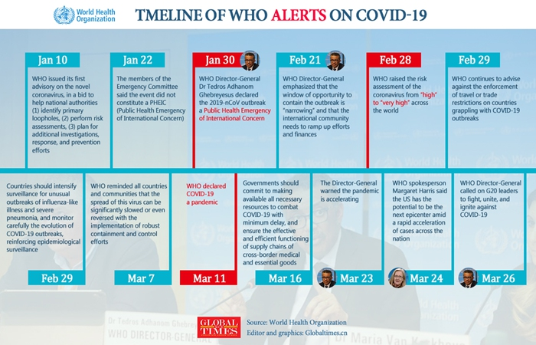
Dec 31 – WHO receives unofficial reports & requests info from China
Jan 3 – China officially notifies WHO of outbreak
Jan 9 – WHO & China agree this is a new virus
Jan 12 – China shares genome with WHO
Jan 28 – Tedros flies to China

Slide 8
Assessment of WHO’s Covid Response
Information Sharing - Data dashboard on case counts, near-daily press briefings largely appreciated
Technical Guidance – Mixed reviews; Experts seen as:
Slow in determining method of transmission
Slow in advising mask-wearing for fear of giving false sense of security and thus not follow social distancing & washing
Assistance to Global South – WHO appeals to members for funding for crucial medical equipment & diagnostics fell far short, thus appeals to individuals → $233 mil ($55 mil from Lady Gaga)
Coordination - Access to Covid-19 Tools Accelerator (ACT) to speed up research & treatment tools; COVAX for production & distribution of vaccines (pooled procurement mechanism). Coordination requires players to be willing to be directed.

Slide 9
Critics of the WHO Covid Response
Politics of Blame – To deflect blame for domestic failures, Donald Trump and administration allies blamed WHO:
For failing to warn the world early enough
And its Director-General for being too “China-centric”
Expert’s Analysis – Covid response revealed problems:
WHO has been drained of power and resources
Left timid and unable to exercise authority to compel China to share information or other governments to act earlier
Member states get what they pay for/order, not what they need

Slide 10
Potential for WHO Reform
Revising the International Health Regulation (IHR) – First time members have considered since SARS.
More Carrots & Sticks - to ensure compliance
More/Stable Financing – to empower authority
PHEIC Designation More Nuanced – not binary decision
IAEA-like Investigative Teams & WTO-like Enforcement Mechanisms
Augment Emergency Committee with Economic & Political Expertise

