Slide 1
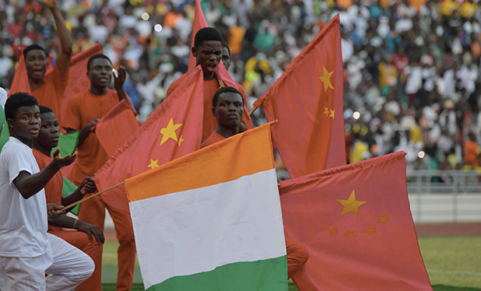
Great Decisions 2021
America’s largest foreign affairs education & discussion program. Now in its 67th year!
CHAPTER 6 The Two Koreas

Slide 2
Challenges Facing South Korea
Issues that threaten to derail South Korea’s aspirations for autonomy, security, and global influence:
Domestic economic & political woes
Intensified Sino-U.S. rivalry, challenging South Korea’s ability to stay out of a great power conflict
Continued North Korean nuclear threat
Will it be forced to choose U.S. or China?

Slide 3
 | North Korea | South Korea
Population | 25+ Million | 51+ Million
Active Troups | 1.19 Mil (4th in world) | 630 K
% Active Military | 4.7% | 1.2%

Slide 4
South Korea’s Candlelight Movement
2016 – Largest peaceful political protests since democratization in late 80s → impeachment of President Park for corruption and later removal from office
2017 – President Moon elected by 41% plurality with mandate to restore accountable government, but he faced economic challenges:
Low growth rates & high youth unemployment
Overdependence on export-led growth, benefiting multinational rather than populous
Inadequate social safety net, especially for elders

Slide 5
Moon’s Initiatives & Outcomes
Real Estate – Raised taxes on landholders with multiple properties, hoping to drive prices down → prices went up
Government Investment in Tech/Environmental Sectors → Increased employment and efficiency in these sectors
Public Sector Reform → Brought backlash, as anti-corruption efforts perceived as revenge rather than reform.
Clean But Cautious → Perceived as weak and led by more partisan advisers

Slide 6
Moon’s Effective COVID Response (1st case same day as U.S.)
Public/Private Cooperation → Rapid development of testing kits and drive-through testing
Cell Phone Technology + Testing → Quick and effective contact tracing, but
Risked outing LGBQT+ at gathering places
Risked targeting church groups opposed to Moon
Quarantine Provisions → Kept positive testers, including foreign travelers and undocumented migrants, away from hospitals while still monitored
Mask-Wearing Compliance → Reduced need for lockdowns
Status of COVID in North Korea unknown

Slide 7
North-South Dialogue & Cooperation
Sunshine Policy of Moon’s Predecessors
1998→2008 – One million South Koreans visited Mount Kumgang (Diamond) Tourism Region on east side of DMZ
2004-16 – Joint industrial complex of 124 textile, chemical, metal, & electronics firms employed >50 K North Koreans
2006-17 – North’s nuclear & missile tests, despite UN Sanctions, soured relations & ended the Sunshine Policy initiatives.
2017 – Originally from the North, newly-elected Moon sought renewed dialogue with goal of peace on denuclearized Korean Peninsula.

Slide 8
North-South Dialogue & Cooperation (cont.)
April, 2018 – 1st N/S Summit → Panmunjom Declaration to formalize people-to-people exchanges, reduce military tensions by reducing guard posts & guns along DMZ, initiate joint remains recovery, and establish an inter-Korean liaison office at Kaesong.
May 2018 – 2nd N/S Summit → Set stage for June summit between Kim & Trump toward reducing UN sanctions for steps toward denuclearization. Trump/Kim summit marginalized Moon and accomplished little.
Sept 2018 – 3rd N/S Summit → Pyongyang Declaration to resume economic, cultural, and family exchanges and dismantle nuclear facilities at 2 sites.

Slide 9
North-South Dialogue & Cooperation (cont.)
4th N/S/U.S Summit Never Materialized
Kim would offer no specific steps to denuclearization without commitments on sanctions relief
Trump would not commit to sanctions relief without clear steps toward complete denuclearization
Moon sought peace & development initiatives as steps toward reducing nuclear threat

Slide 10
U.S.-South Korea Alliance Stresses under Trump & Moon
Differing Goals – Denuclearization vs. Peace & development
Differing Styles – Brash & direct vs. Cautious but firm
Differing Relationship with China – Adversarial vs. Collaborative
Moon Caught – Can’t bring about sanctions relief without U.S.
Trump’s Demands to Reduce South Korea’s “Free Ridership”
2019 – Moon agreed to increase defense cost-sharing by 8% to $860 million
2020 – Trump increased the demand 500% to $4.6 billion; Moon agreed to 13% or $1 billion

Slide 11
Questions on Future U.S. Policy
China – Assuming China is necessary for for any denuclearization progress, how can we bring China to the table?
South Korea – If forced to choose between China & U.S., which nation is most likely to meet South Korea’s interests?
Complete Denuclearization – Is this the appropriate goal of U.S. policy?
Nuclear Risk – How likely is it that Kim would launch an unprovoked nuclear attack?

