Slide 1
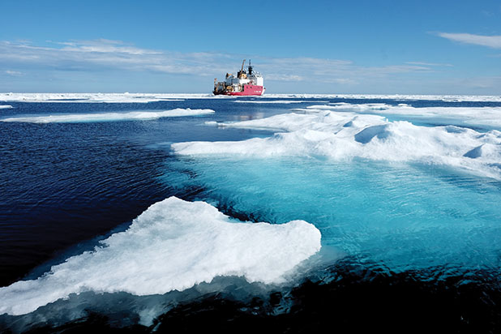
Great Decisions 2021
America’s largest foreign affairs education & discussion program.
Now in its 67th year!
CHAPTER 4
The Arctic:
Return of Great Power Rivalry

Slide 2
Nations of the Arctic
Arctic Coastal States | Other Nations within Arctic Circle
Canada | Finland
Denmark | Iceland’s EEZ
Norway | Sweden
Russia
United States

Slide 3
Russian Military
U.S. Military

Slide 5
International Organizations/Agreements Relevant to the Arctic
1957 – North American Aerospace Defense Command (NORAD). U.S. & Canada to jointly defend against air/space threats
1996 – Arctic Council for environment & sustainable development, comprising 8 Arctic Nations and 6 Indigenous Peoples’ Organizations. As of 2020, 13 non-Arctic nations have observer status (Switzerland!) Further declarations/agreements:
2011 – Search & rescue
2013 – Marine oil pollution preparedness & response
2017 – Scientific cooperation
2019 – No Common Declaration, as U.S. refused to accept any reference to global warming

Slide 6
Ongoing Issues within the Arctic
Canada – Requires every ship within Northwest Passage to register with Canadian Coast Guard, a claim based on UNCLOS treaty, which U.S. challenges
Greenland/Denmark – Increasing U.S. interest led to expanding Thule Air Base, reopening consulate in Nuuk, expanded development aid, and Trump’s offer to buy Greenland
Norway – Russian assertiveness around Kola Peninsula brought calls for expanded NATO presence in the Arctic.
Russia – Similar to Canada, Russia claims under UNCLOS right to impose fees for passage through Northern Sea Route and require Russian icebreaker escort.

Slide 7
United Nations Convention on
The Law of the Sea (UNCLOS)
1982-94 – The Law of the Sea Treaty was negotiated and came into effect once 60 nations ratified it. There are now 167 parties to the treaty.
UNCLOS defines the rights and responsibilities of nations with respect to their use of the world’s oceans, establishing guidelines for businesses, the environment, and the management of marine natural resources.
U.S. – Reagan had some reservations about UNCLOS, but these were addressed in amendments under Bush 1, so in 1994, Clinton signed the agreement, but the Senate never ratified it.
2012 – The Pentagon, the U.S. Chamber of Commerce, every living former Secretary State, the Senate Foreign Relations Committee (SFRC), and many others sought to get the treaty ratified, but 34 Republicans gave SFRC Chairman John Kerry a letter pledging to vote NO, thus scuttling any hope. No further attempts have been made.

Slide 8
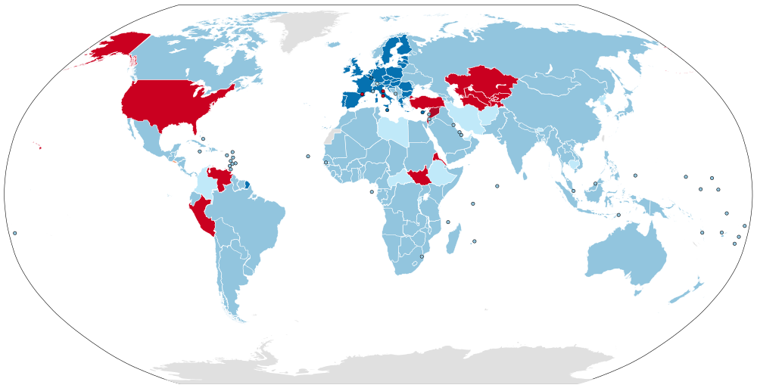
Parties Signatories Non-parties
Parties, dually represented by the European Union
Parties to the Law of the Sea Treaty

Slide 9
The Arctic Institute on June 2020 Memo
A Shifting Focus of U.S. Arctic Policy
Trump presidential memo focused Arctic policy on:
  perceived threat from China, AND
  an overwhelmingly military response
Called for:
  Launching 6 new “polar security cutters,”
  Launching 3 heavy icebreakers by 2029, and
  Establishing 2 domestic and 2 international support bases
Obama-era Arctic policies made no mention of China; no clear Arctic policy as yet from Biden

Slide 10
Discussion Questions
Arctic Council – Should the Arctic Council countries prioritize policies to limit melting of Arctic ice?
U. S. Reluctance – Why has the U.S. been a “reluctant” Arctic nation in the past?
U.S. Interests – What are our primary interests in the Arctic? Within what fora/groups should the U.S. be pursuing those interests?
China & Russia – Do we need to catch up? Are the challenges from these countries’ increased activity in the Arctic the same or different?

