Slide 1
Great Decisions 2021
America’s largest foreign affairs education & discussion program. Now in its 67th year!
CHAPTER 3
Brexit and the EU

Slide 2
Timeline of U.K’s Reluctant EU Integration
Post WWII – Churchill argued for a U.S. of Europe
1949 – Council of Europe with U.K. as a founding member
1951 – European Coal & Steel Community (ECSC), which Britain declined to join
1957 – Treaty of Rome stablished the European Economic Council (EEC), which Britain declined to join
1961 – Britain sought entry into EEC, but blocked by France
1973 – Britain joins EEC, along with Denmark & Ireland
1976 – EEC referendum in U.K. results in 67% support
1981 – Greece joins EEC, then 1986 – Spain & Portugal

Slide 3
Timeline of European Integration (cont.)
1985 – Schengen Agreement eliminates internal border checks amongst 5 states, which would grow to 26.
1992 – Maastricht Treaty establishes European Union (EU), moving toward an economic & monetary union
1994 – Sweden, Austria, & Finland join EU, covering western Europe except Switzerland & Norway
1999 – Eurozone of 12 countries is largest cash changeover in history, with Sweden, U.K. & Denmark opting out
Post-Soviet Union → 2013 – Several eastern European countries joined EU, with most recent being Croatia

Slide 4
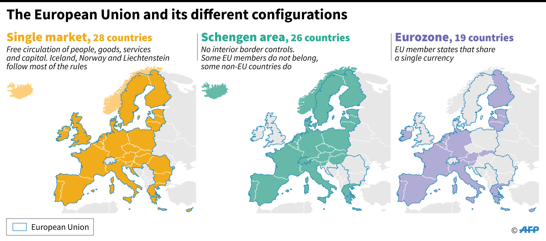
EU/Schengen Area/Eurozone before Brexit
EU + Iceland, Norway & Switzerland
EU - Ireland, UK, Croatia, Bulgaria & Romania
EU - UK, Sweden, Denmark, Czech Rep, Poland, Croatia, Hungary,
Romania, & Bulgaria

Slide 5
The Road to Euroskepticism
1997 – Labour Party landslide allowed PM Tony Blair to institute social protections coveted his political left
2009 – Euro crisis & 2015 Migration crisis made Euroskepticism a wedge issue within both Conservative & Labour parties. Pro-EU Liberal Democrats broke away from Labour & Anti-EU U.K. Independence Party broke from Conservatives
2014 – UKIP won big in local elections and largest number of seats of UK’s European Parliament of any party.
2015 – European Union Referendum Act (EURA) passed U.K House 544 to 53, but actually didn’t require the government to implement the referendum’s results

Slide 6
U.K. BREXIT VOTE: LEAVE 51.8% REMAIN 48.1%
LEAVE campaign focused on immigration and revealed extent to which racism remains in U.K.
LEAVE campaign also benefited from pervasive income inequality, one of highest in western world
REMAIN campaign suffered from Pro-EU Prime Minister David Cameron’s hesitancy to aggressively work against LEAVEers like Boris Johnson in his own Conservative party
REMAIN campaign suffered from failure to counter false economic ads
62% REMAIN
56% REMAIN

Slide 7
The Brexit Fallout for Brits
Christmas Eve Brexit Agreement – Avoids many of the hard Brexit pitfalls but still has impacts:
Irish Border – Allows an all-but-invisible border, without checkpoints between Northern Ireland and the Irish Republic
British Residents in EU – EU Members will set their own guidelines for any continuing residency by Brits
EU Residents in U.K. – Many with less-than-permanent status will have to apply for residency under new immigration guidelines
Trade – Goods will not face additional tariffs, but there will be additional transaction costs from new licenses and certificates
See BBC, “Brexit: Seven Things Changing on 1 January” at https://www.bbc.com/news/uk-politics-32810887

Slide 8
The General Brexit Fallout
British Regional Influence – With new deal, Britain may find itself subject to EU regulations without a vote. Financial interests may shift from London to Dublin, Paris, & Frankfurt
British Global Influence – Retains leadership of 2.4 billion-strong British Commonwealth, but role as U.S. intermediary with Europe will likely shift to Germany & France
Scottish Independence Movement – 2014 referendum was defeated 55.3% to 44.7%, but Brexit and inept U.K. handling of COVID have rejuvenated the movement. Poll shows 58% pro-independence in 2020.
EU Stability – EU lost its 2nd largest economy and opened door to other exiters, but remaining members showed remarkable solidarity in Brexit negotiations

Slide 9
Discussion Questions
U.K. – Do you think the British might have a change of heart and reapply to the EU?
Scotland – Will the Scottish vote to leave the U.K?
EU – Are there other members who might now consider leaving? Who will step up and take command of Europe once Angela Merkel is out of the spotlight?
U.S. with U.K./EU – Should the U.S. prioritize its “special relationship” with the U.K. or the EU?
Brexit & MAGA – Do you see parallels between these two movements?

