Slide 1
Great Decisions 2021
America’s largest foreign affairs education & discussion program. Now in its 67th year!
CHAPTER 2
Persian Gulf Security

Slide 2
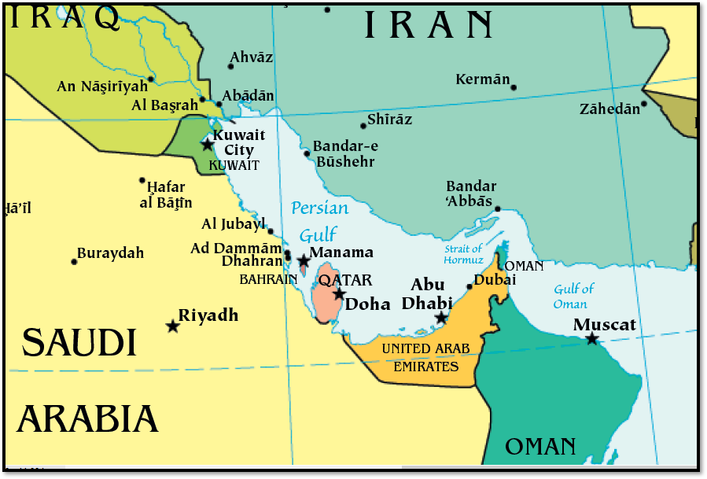
The Eight Gulf States
Nation State | Pop (mil.) | Area (sq. mi.) | % Shia/ Sunni
Iran | 83 | 636,000 | ~95/5
Iraq | 38 | 169,000 | ~60/40
Saudi* | 34 | 830,000 | ~20/80
UAE* | 10 | 32,000 | ~15/85
Oman* | 4.9 | 120,000 | ?
Kuwait* | 4.4 | 6,900 | ~40/60
Qatar* | 2.8 | 4,500 | ~10/90
Bahrain* | 1.6 | 300 | ~62/38
TOTAL | ~180 | 1,800,000 | Shia>Sunni
*Gulf Cooperation Council (GCC)

Slide 3
Timeline of Gulf History
Post WWI – Defeat of Ottoman Empire left Great Britain to draw modern state borders and lead oil exploration
1953 – U.S. and Britain collude to overthrow democratically-elected Mossadegh government over oil nationalization
1971 – British withdraw from the Gulf, leaving U.S. dominant. U.S. “outsourced” Gulf security to Saudi/Iran “Twin Pillars”
1978/9 – Iranian Revolution, leading U.S. to shift security focus to Gulf Cooperation Council (GCC)
1987 – U.S. expands military presence to protect oil tankers and oil flow in Gulf, threatened by Iran/Iraq war

Slide 4
Timeline of Gulf History (cont.)
1990/91 – Gulf War, pushing Iraq out of Kuwait & escalating U.S. military involvement → U.S. 5th fleet in Bahrain, a major army bases in Kuwait, and a key airbase in Qatar. (presently ~45,000-65,000 U.S. troops in Gulf region)
2002 – George Bush designates Iran part of an “Axis of Evil”
2003 – U.S. invades Iraq to overthrow Saddam & seek WMD
2009/10 – U.S. & Israel infect & disable computers in Iranian nuclear plant
2011 – Arab Spring thoroughly rattles Gulf monarchs. U.S. supports overthrow of Mubarak in Egypt but quietly supports ruling families in Gulf (Saudi Arabia & Bahrain)

Slide 5
Timeline of Gulf History (cont.)
2015 – Joint Comprehensive Plan of Action (JCPOA or Iran Nuclear Agreement) signed between Iran and the 5 permanent members of the UN Security Council.
2017 – Conflict arises between Qatar and quartet of adversaries: Saudi, UAE, Bahrain, and Egypt. Qatar shifts trading relationships to Turkey & Iran, collapsing GCC.
2018 – U.S. withdraws from JCPOA & seeks to persuade the UN Security Council to re-impose pre-deal sanctions on Iran
2019 – Iran launches air attacks against a Saudi Aramco oil facility

Slide 6
Timeline of Gulf History (cont.)
2020 – U.S. drone assassinates Iranian General Soleymani.
– “Abraham Accords” normalize relations between Israel and UAE & Bahrain (joining Egypt & Jordan).
2021 – Biden announces intent to:
  quit selling arms to Saudi Arabia used to fight in Yemen civil war
  end sanctions & rejoin JCPOA if Iran comes back into compliance

Slide 7
Policy Options facing Biden Administration
Stay or go in the Gulf? – By 2018, U.S. importing, only 15% of its oil from Gulf. Demand for oil greatly reduced now. Reduce military and shift to political/economic diplomacy?
Future of U.S. bases? – Pull back to pre-1990 deployment from Indian Ocean, allowing for more robust critique of human rights abuses? Does there continue to be a need to police threats to navigation?
Renew Iran deal? – Does the original deal serve our interests, or do we need to push for broader conditions?
Support a Gulf security organization? – Is it possible to include all Gulf states, encouraging more self-sufficiency and collaboration? Does a potential U.S. pullback push states toward cooperation or conflict?

